Slide 1

Employee Management System
ICT3183-Group Project GP-2024-07 2024-02-02
TG/2020/676 -A.Asama
TG/2020/684 -M.A.D.A.M.Arachchi
TG/2020/709 -G.P.W.Sathma
TG/2020/712 -R.M.S.M Rathnayake

Slide 2

Introduction
The main intent of this project is to ease the work of unique venture to online manage all the records of clients and their employees by providing them a web based application. Also proper employee management system is achieved which is a very tedious and difficult job to handle all employees manually for unique venture.
The proposed software project of Employee Management system,
keeps a central record of employee details
Keep attendance and work hours
generates reports
handles leave requests.
Salary Calculate

Slide 3
Problem statement
A system to manage employees and calculate their salaries without manual ways.
Manages the organization and employees in a better way.
The current manual system in place may result in inefficiencies, miscommunication, and difficulties in tracking employee performance. To address these challenges, the development of a comprehensive Cleaning Service Employee Management System is proposed.

Slide 4
Aims and objectives
Enhance workforce efficiency
Ensure the security of data and information
Develop a centralized employee database
Integrate reporting and analytics

Slide 5
Scope of work
Managing employees
Calculating salaries
Leave and Attendance
Monthly report generating
Inventory System
Admin Dashboard
Employee Dashboard

Slide 6
Methodology
Agile development
Agile is a software development methodology to build a software incrementally using short iterations of 1 to 4 weeks so that the development is aligned with the changing business needs. an agile team works in iterations to deliver user requirements where each iteration is of 10 to 15 days.

Slide 7
Target audience
Stakeholders
Owners
Employees
Staff

Slide 8
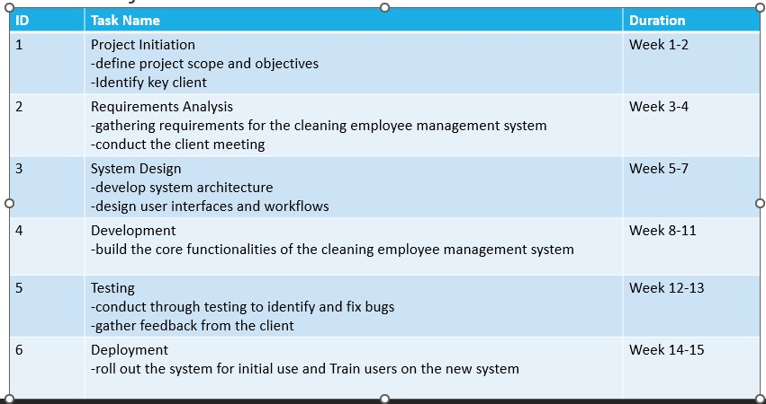
Project Timeline

Slide 9
Budget
Expense Category | Description | Estimated Cost(Rs.)
Hosting | Cloud hosting for the management system | 8 000 .00
Domain | Purchase and registration of the domain | 8 000 .00
Internet Connectivity | Monthly internet service for the organization | 6 000 .00
Total Cost |  | 22 000.00

Slide 10
Risk Assessment
1. Technical Challenges:
- Risk : Unforeseen technical complexities during system development.
- Mitigation: Conduct a thorough feasibility study, engage experienced developers, and implement an agile development approach to address and adapt to emerging technical challenges.
2. User Adoption Resistance:
- Risk : Resistance from cleaning staff to adopt the new system.
- Mitigation: Involve end-users in the development process, provide comprehensive training, and communicate the benefits of the system to gain user buy-in.

Slide 11
3. Scope Creep:
- Risk : Expanding project scope without proper control.
- Mitigation: Clearly define project scope, establish a change control process, and involve stakeholders in decision-making to prevent unnecessary scope changes.
4. Budget Overruns:
- Risk : Exceeding allocated budget due to unforeseen expenses.
- Mitigation: Regularly monitor expenses, create a contingency budget, and prioritize project features to ensure critical functionalities are delivered within budget constraints.

Slide 12
Team members and roles
Index with Name | Main Function | Sub Function
TG/2020/684 -M.A.D.A.M.Arachchi | Employee Management | Add and Delete Employee Update and View Details Assigning Tasks to staff Monthly Generate Reports
TG/2020/712 -R.M.S.M Rathnayake | Inventory Management | Add and Delete Stock Update and View Stock Monthly Generate Report

Slide 13
TG/2020/676 -A.Asama | Leave and Attendance | Manage Staff Leave (Approve or Reject) View Leave History Staff Can Apply Leave and View Maintain Attendance Monthly Report Generate Message Service
TG/2020/709 -G.P.W.Sathma | Calculate Salary | Add Salary Manage Salary Calculate Etf , Epf Monthly Report Generate Message Service

Slide 14
Communication and reporting
We communicate with our client via online.
we communicate with our group members physically and virtually.
Weekly/Monthly Progress Reports

Slide 15
Hardware and Software Requirements for the project
Hardware Requirements
1. Laptop
2. Router
Software Requirements
DBMS : MySQL
Programming Languages : PHP/HTML/CSS/JavaScript
Software Framework : Bootstrap
Development Tools:
Git
IDE – Visual Studio Code.

Slide 16
Testing and quality assurance
1. Testing Phases:
- Unit Testing
- Integration Testing
- System Testing
- User Acceptance Testing (UAT)
2. Quality Assurance Measures:
- Code Reviews
- Automated Testing
- Performance Testing
- Security Testing

Slide 17
Importance of Ensuring a Robust and Reliable Software Product:
1. User Satisfaction
2. Operational Efficiency
3. Cost Savings
4. Brand Reputation

Slide 18


Conclusion
The results were discussed, problems faced and limitations were elaborated. Future recommendations for the extension and improvement of the system have also been discussed as well as an assessment of achieved functionality.

Slide 19

References
YouTube
Internet

Slide 20

Questions

Slide 21

Thank you
TG/2020/676 -A.Asama
TG/2020/684 -M.A.D.A.M.Arachchi
TG/2020/709 -G.P.W.Sathma
TG/2020/712 -R.M.S.M Rathnayake

